Slide 1
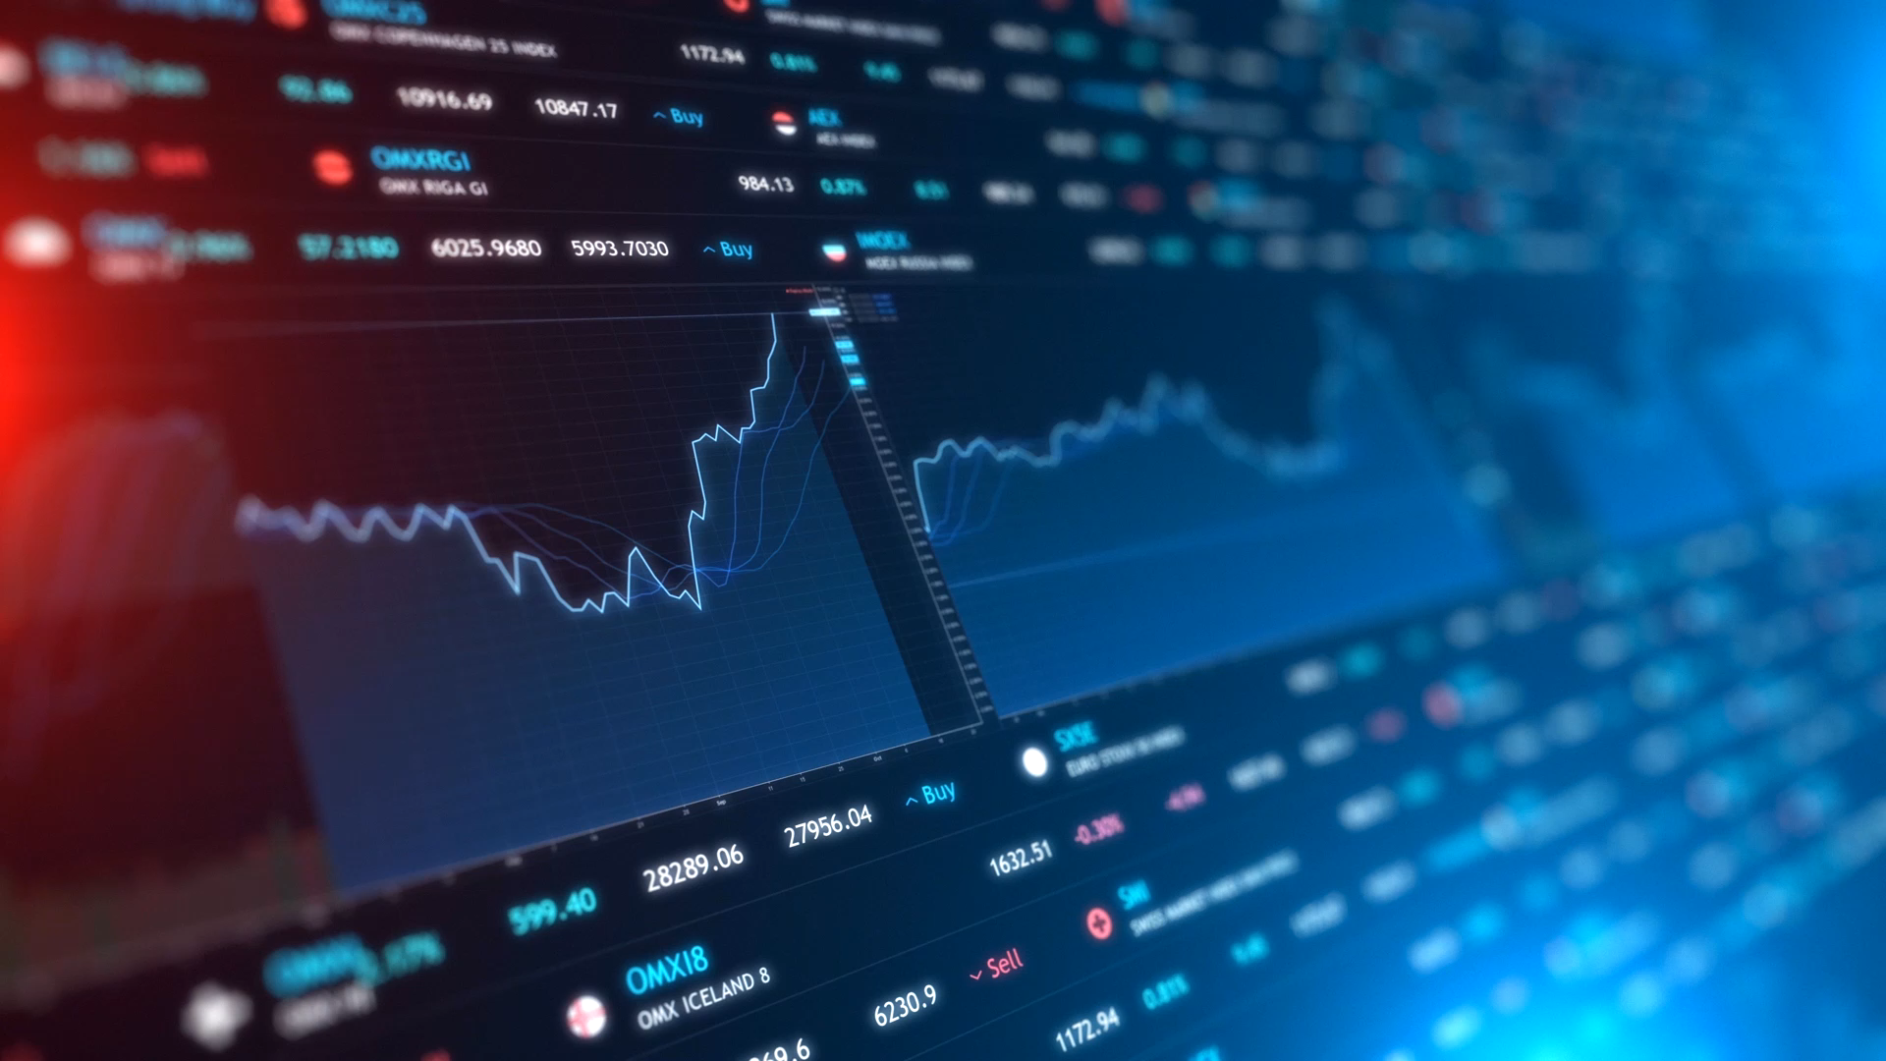
Technical Indicator Backtest Study
June 18, 2021

Slide 2
Goals
Trading Signals will be evaluated in two areas:
Returns – Calculate the returns following ALL of the trading signals. This will necessarily differ from a trading simulation in that in a trading environment signals generated while a trade is in progress may be ignored.
Support – How effect is the signal in setting a support level for the sale of a bull credit spread.
In each case two scenarios are evaluated:
CLOSING PRICE SCENARIO: Returns and support generated coincident with the signal in which case the close of the signal bar will be used to fix the “entry” price for returns calculations and to activate the support level.
BUY STOP SCENARIO: In this scenario the concept is that we wait until the high of the signal bar is taken out by the following bar. Once this has occurred, we measure returns based upon the high price of the signal bar. The support level in the buy stop scenario remains the low of the signal bar. Optionally the code could be changed to evaluate using the low of the bar that triggered the “trade” or any other price.
Multiple technical signals will be evaluated and the results compared in order to settle on specific signals that can be used in further testing.
The primary goal of this study is to identify the trading signals with the highest potential.

Slide 3
Signals to be Considered
Volatility Compression (ATR Compression)
Awesome Oscillator
CCI – Commodities Channel Indicator
DRSI – Double Stoch RSI
KCUM – Keltner Center Channel Crossover
Key Reversals
MACD
Sigma Spikes
New signals can be easily added

Slide 4
Algorithms – Overview
Data for a given symbol will be downloaded from Yahoo finance.
Development will be done with Jupyter Notebook. A parallel development will be undertaken in Anacoda/Python in order to manage larger files and access data not available from Yahoo.
Each trading signal will be implemented in its own notebook.
A cell in the notebook will be dedicated to downloading price data. This cell can be modified to support other data source.
A cell in the notebook will be dedicated to calculating the indicator. To add a new indicator only this cell would need to be changed.
The remaining cells calculate returns over from 1 to 15 bars, plot the results and then do a comparison with random results. A simple comparison of random trials was done.
An analysis of the Closing Price Scenario is then followed by an analysis of the Buy Stop Scenario.
For returns the appropriate returns statistics are reported.
For the support case the percentage of samples in which the support held is reported.
Initial testing will be done on 1 day and 15 minute SPY data. The algorithm is flexible and can handle any interval. (Yahoo is having issues with SPX…)

Slide 5

Return Analysis SPY Daily Results

Slide 6
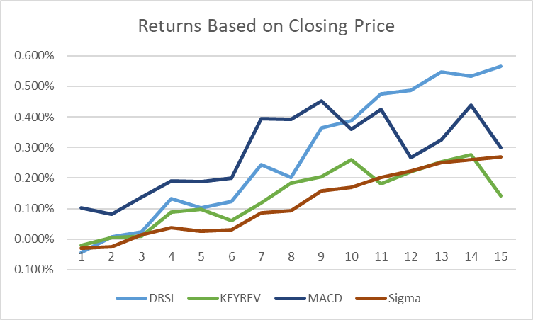
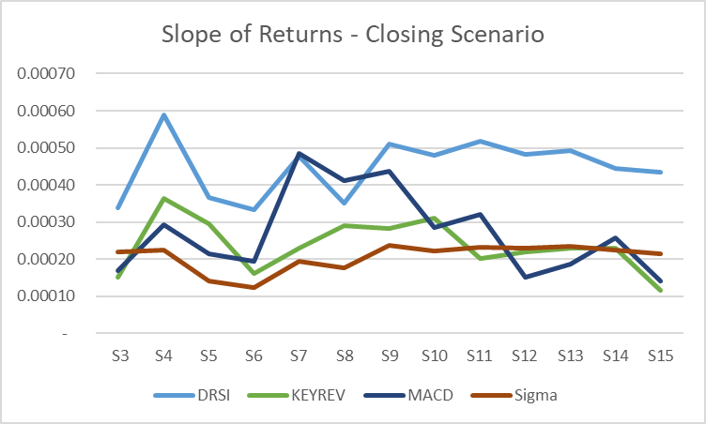
SPY – Closing Price Scenario (Daily – YF 6/1/2000 – 6/6/2021)
Underperformers were dropped from the graph.

Slide 7
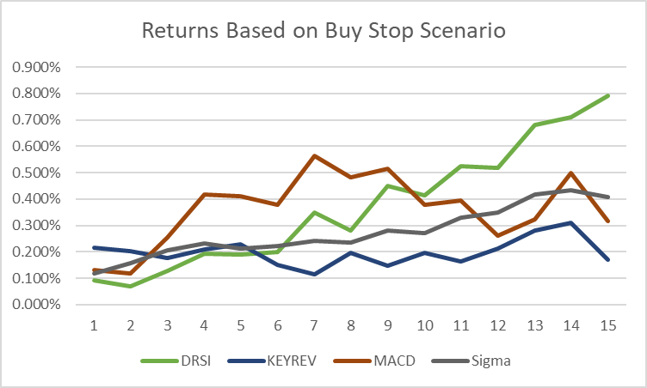
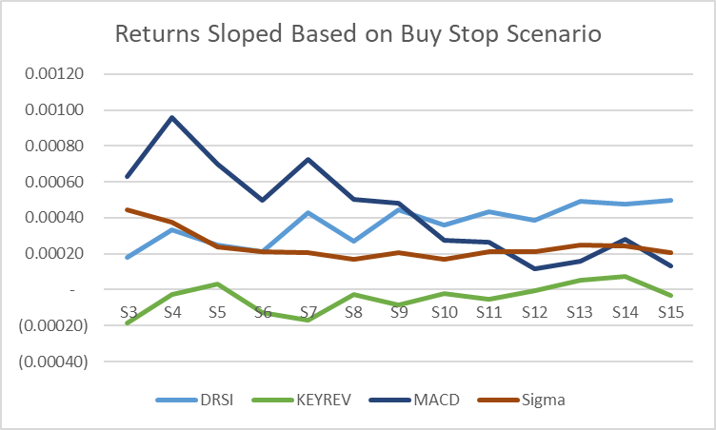
SPY – Buy Stop Scenario (Daily – YF 6/1/2000 – 6/6/2021)
Underperformers were dropped from the graph.

Slide 8
Return Analysis SPY 15 Min Results

Slide 9
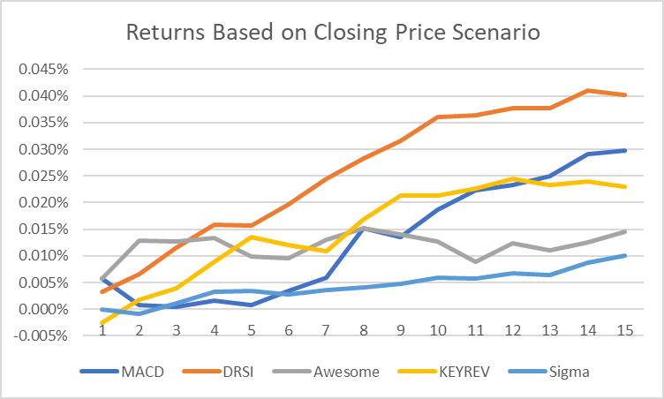
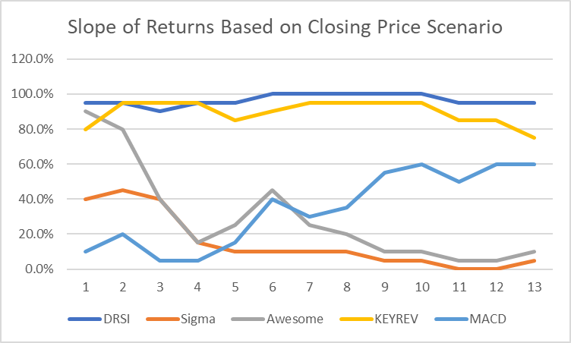
SPY – Closing Price Scenario (15 min – TS 6/19/2006 – 6/17/2021)
Underperformers were dropped from the graph.

Slide 10
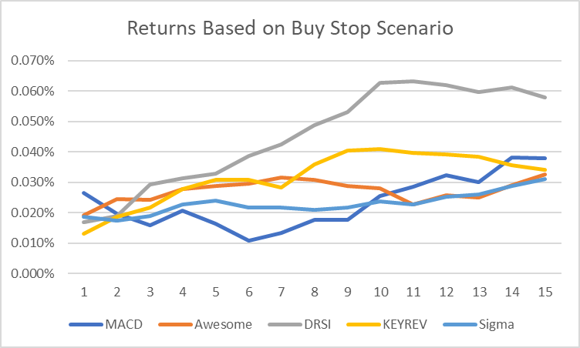
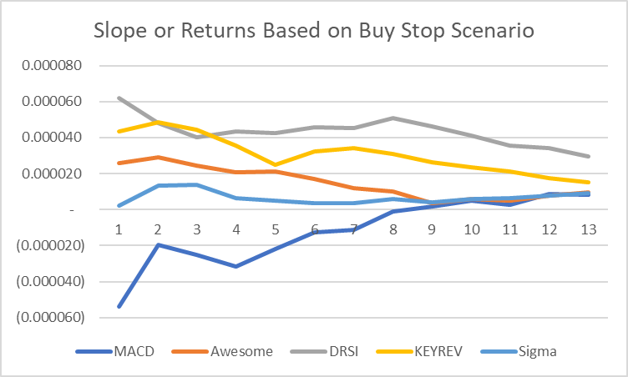
SPY – Buy Stop Scenario (15 min – TS 6/19/2006 – 6/17/2021)
Underperformers were dropped from the graph.

Slide 11
Support Analysis

Slide 12
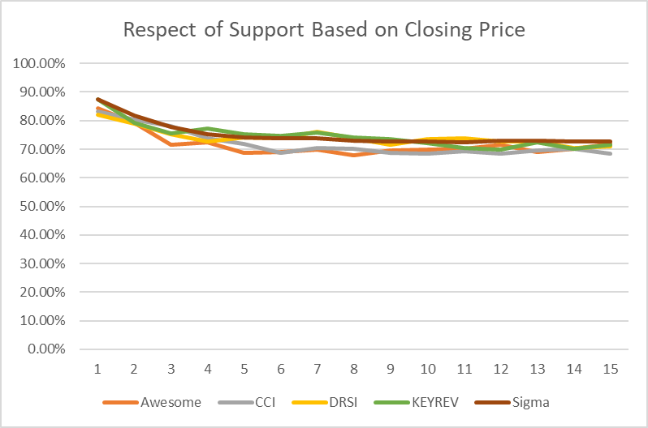
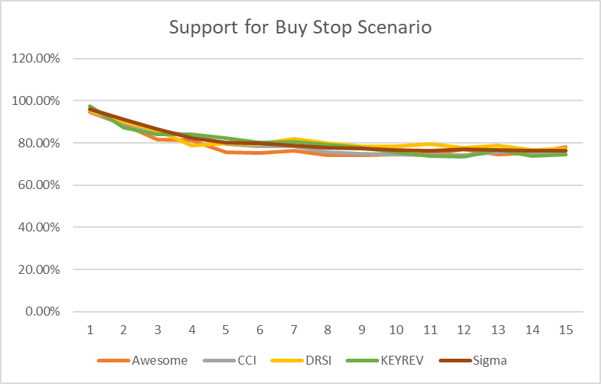
SPY – Respect for Support (Daily – YF 6/1/2000 – 6/6/2021)
Underperformers were dropped from the graph.

Slide 13
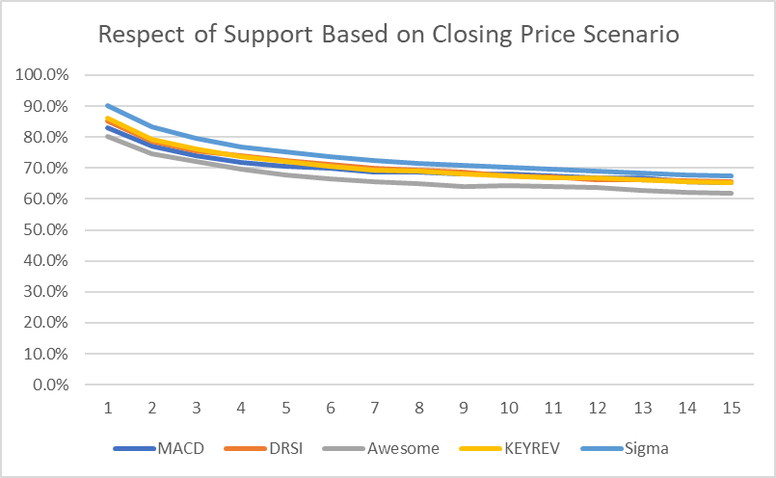
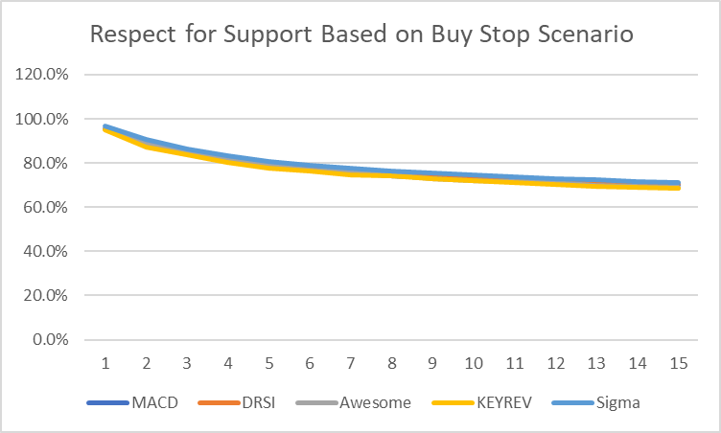
SPY – Respect for Support (15 min – TS 6/19/2006 – 6/17/2021)
Underperformers were dropped from the graph.

Slide 14
Conclusions
The better performing signals for providing both returns and support were:
DRSI
Key reversals
Sigma Spikes
MACD
Awesome
ATRC is a special case in that it spikes then seems to revert to the mean. The signal is very short lived.
These signals provide a reasonable number of opportunities and may benefit from some type of filtering or inclusion in a machine learning environment.
Additional study of modified and/or filtered RSI indicators may also be appropriate.

Slide 15
Next Steps/Notes
Look at Short Side
Classic short signals
Can a maximum close after a given long signal be used to fix an upper bound for a call sale to form an Iron Condor
Can a variable day chart or non-standard chart we used to gain more accuracy? For example, a 1.5, 2, or 2.5 day chart.
Can I easily feed daily trading signals to intraday data?
Set up a method for testing Machine Learning algos and determine the best mix of signals.
Can KATR or similar bands be used to select options for Iron Condors.
Somewhere in here I want to start folding these results back into options chain testing.

